Slide 1
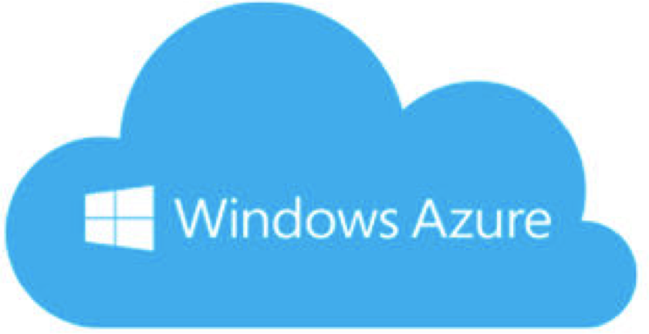






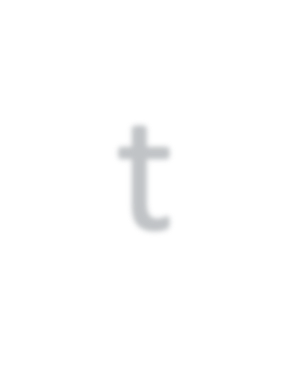






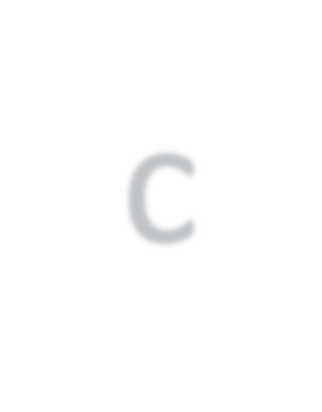


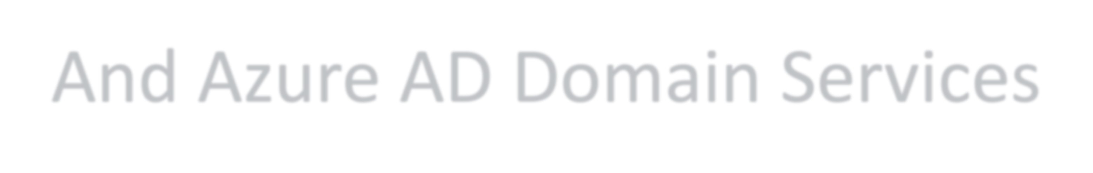


Azure ActiveDirectory
And Azure AD Domain Services
Himanshu Rana
Microsoft Certified Trainer, Consultant
https://in.linkedin.com/in/himanshu1987

Slide 2

Course Overview
Azure Active Directory
Azure Active Directory Domain Services
Azure ADDS Deployment Scenarios and Use Cases Hands-On Configuring Azure ADDS

Slide 3
Introducing Azure Active Directory

Slide 4
Module Overview
What is Azure Active Directory
How it is different from On-Premises Active Directory Licenses of Azure AD
Azure AD Tenants and Azure Subscriptions

Slide 5
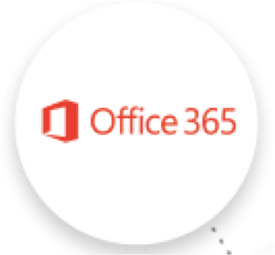
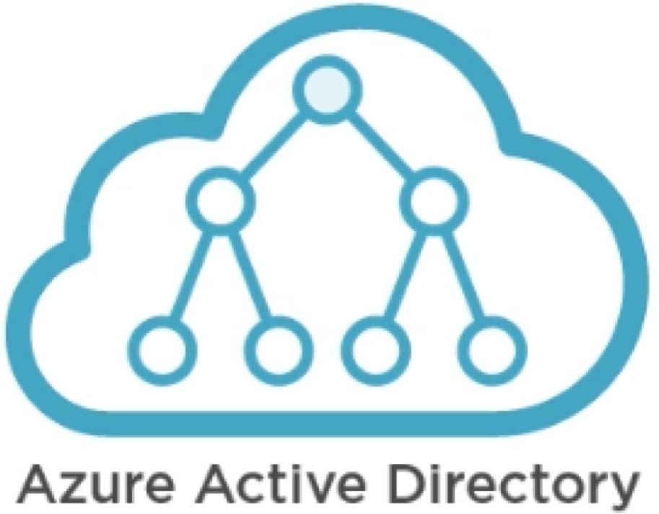
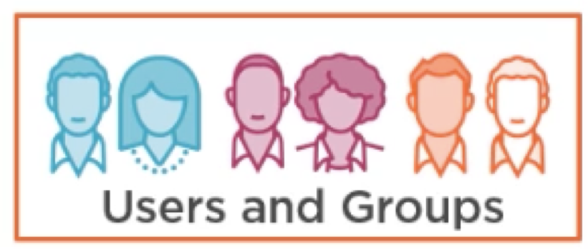
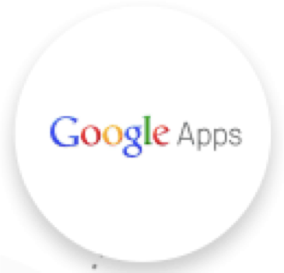

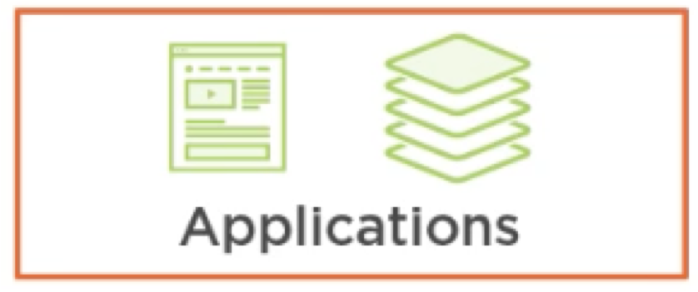


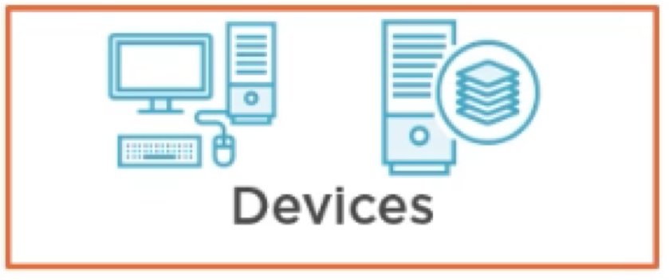
Azure Active Directory (AAD)

Slide 6
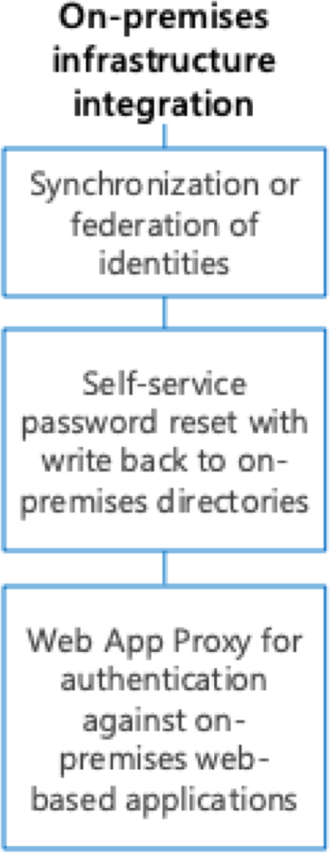
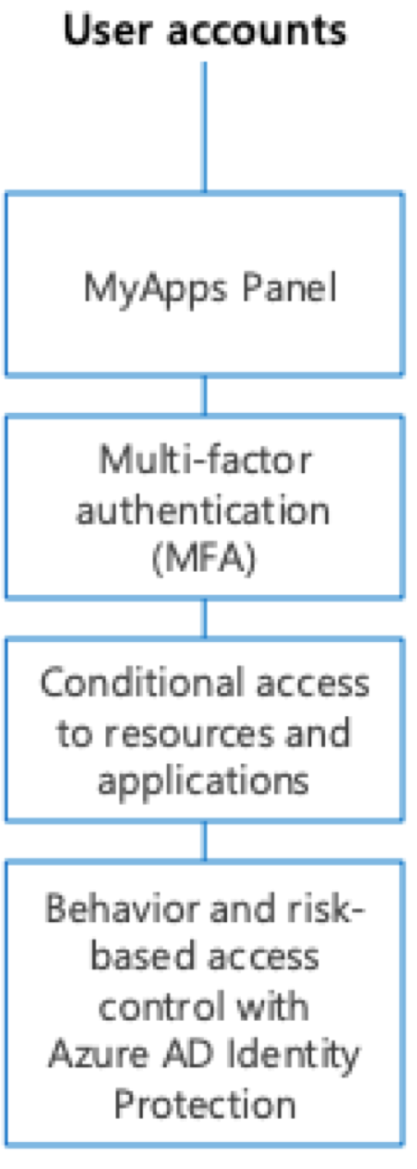
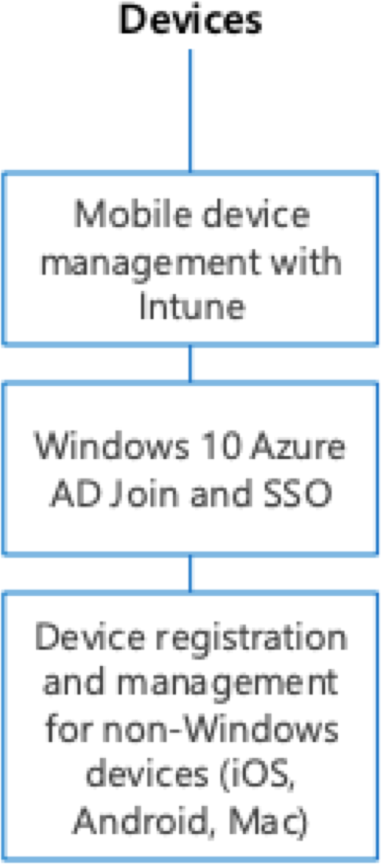
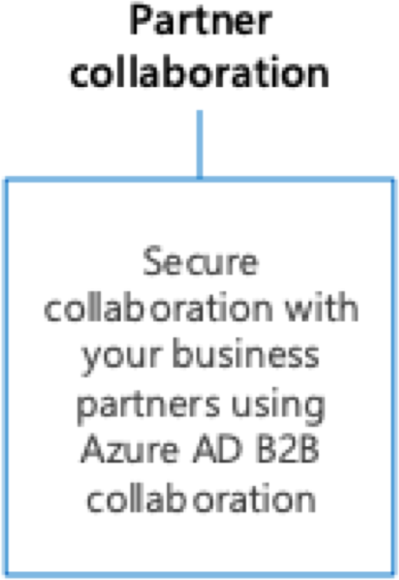
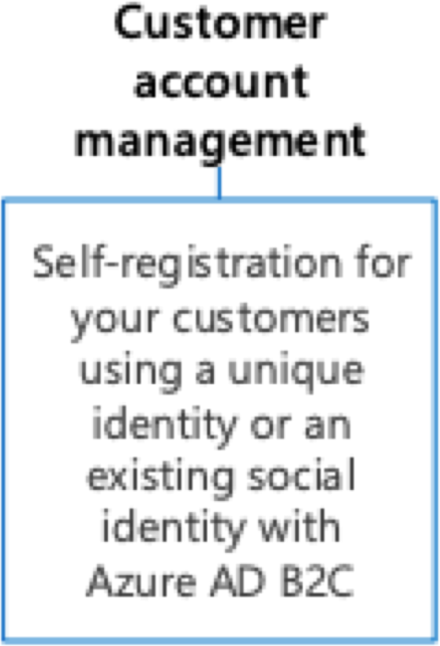
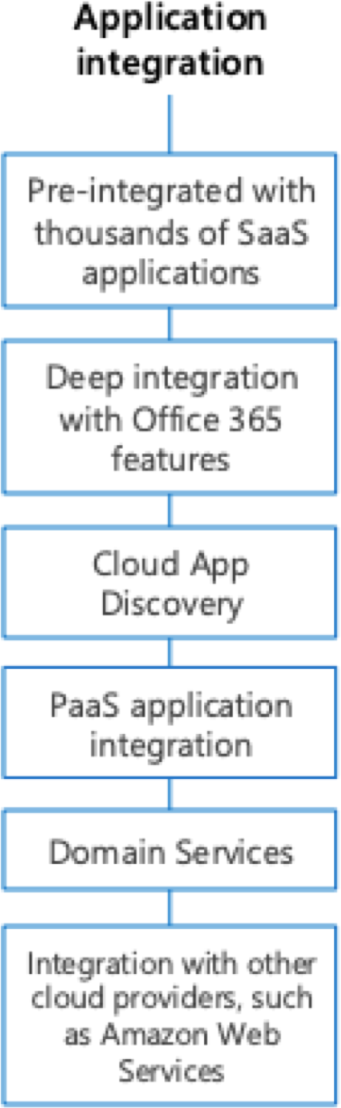
Azure Active Directory

Slide 7
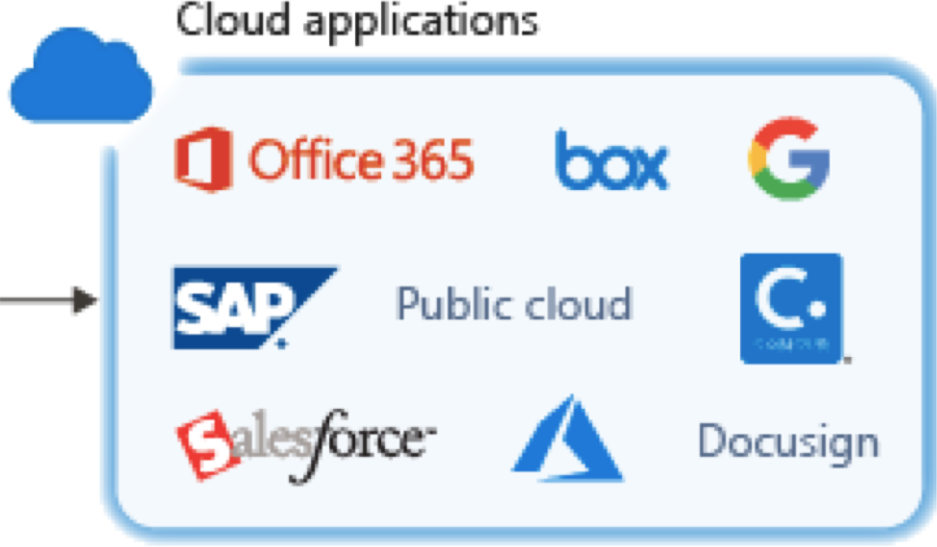
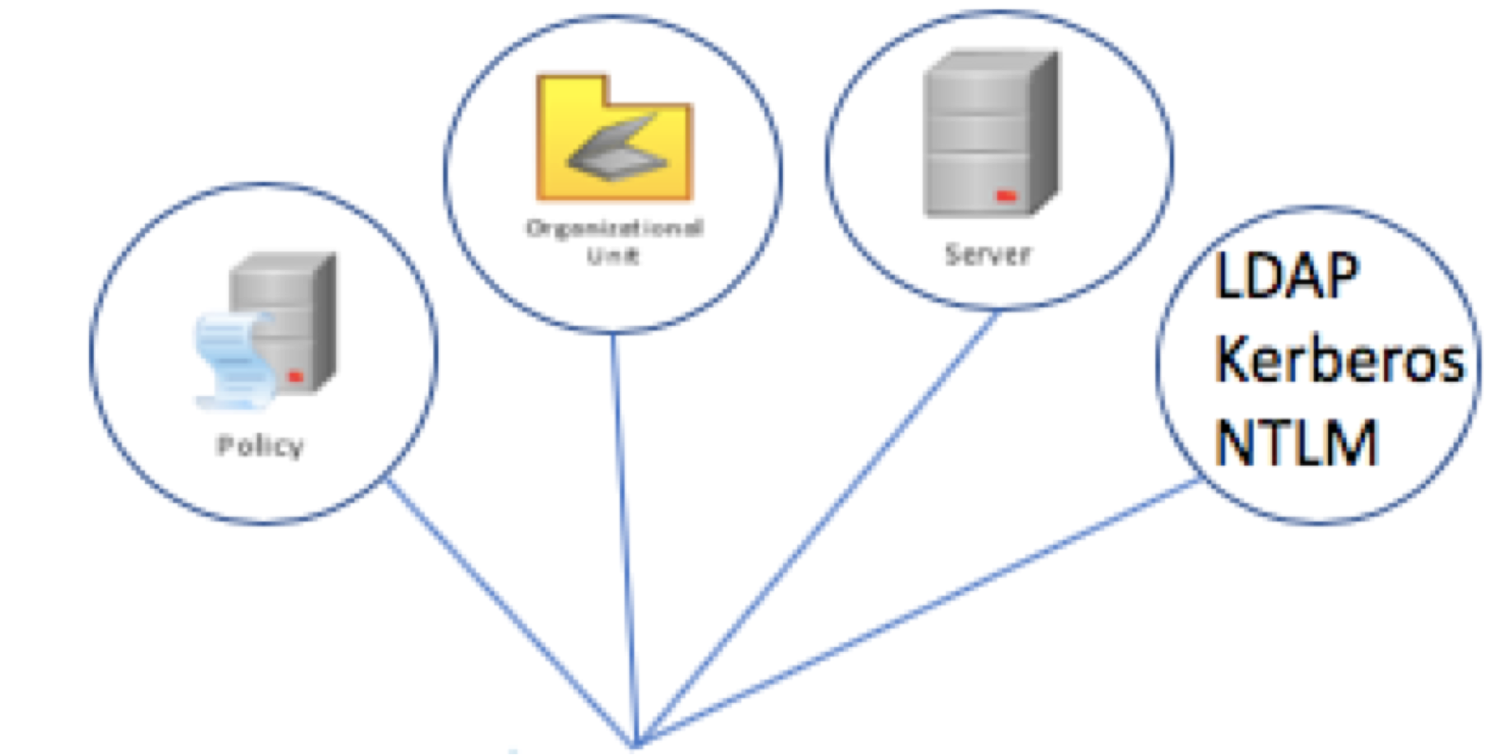

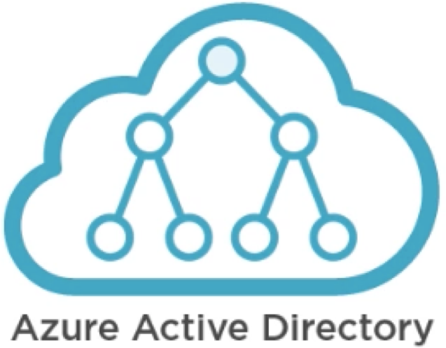

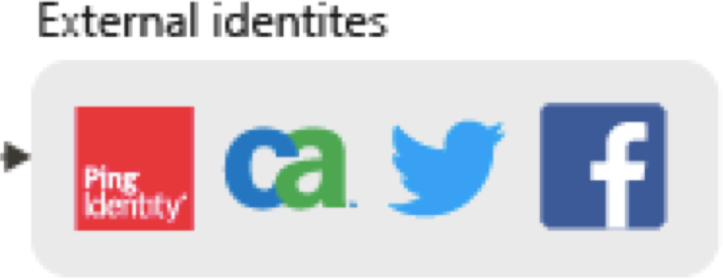
Azure Active Directory (AAD) vs On-Prem AD
SAML
Oauth
OpenID WSFed
AAD Connect
On Premises Active Directory

Slide 8
Azure Active Directory Licenses (SKUs)

Slide 9
An Azure AD tenant is an instance of Active Directory on Cloud and pretty much represents an organization
Hosted in Shared Infrastructure where every tenant is isolated with each other
Azure AD Tenants
Any application that want to use Azure AD for authentication must be registered with Azure AD
All Microsoft SAAS services e.g. O365, SharePoint are leveraging Azure AD for Identity management and directory services.
More than one tenant is not recommended but can be created from Azure Portal or Powershell, however there are limitations.

Slide 10
An Azure subscription grants you access to Azure services and to the Azure Platform Management Portal
The subscription holder manages services (Windows Azure , SQL Azure, Storage etc) through the Azure Platform Management Portal
Azure Subscriptions
An Azure subscription has a trust relationship with Azure Active Directory (Azure AD), which means that the subscription trusts Azure AD to authenticate users, services, and devices
Multiple subscriptions can trust the same Azure AD directory, but each subscription can only trust a single directory.
If your subscription expires, you lose access to all the other resources associated with the subscription.
Multiple Subscriptions are created to separate production, Dev, Test workloads or for separate billings.

Slide 11
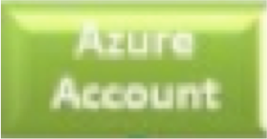
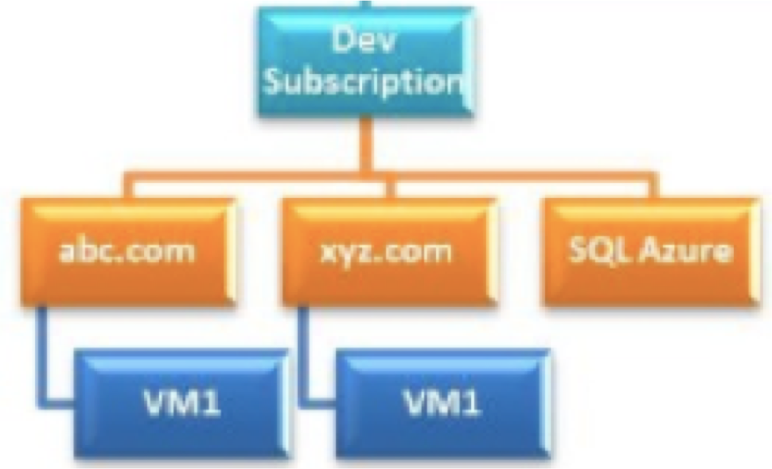
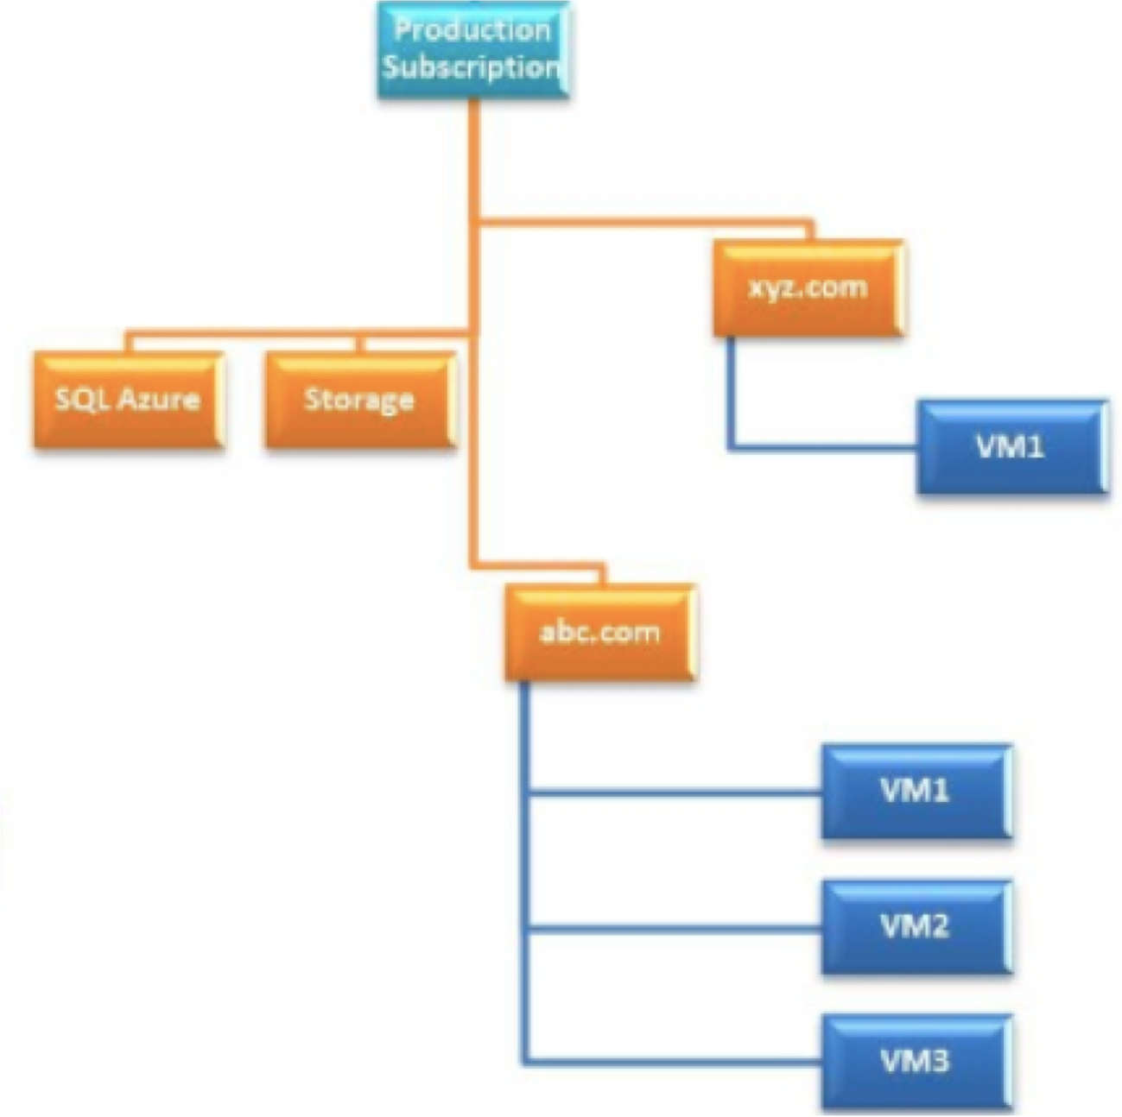
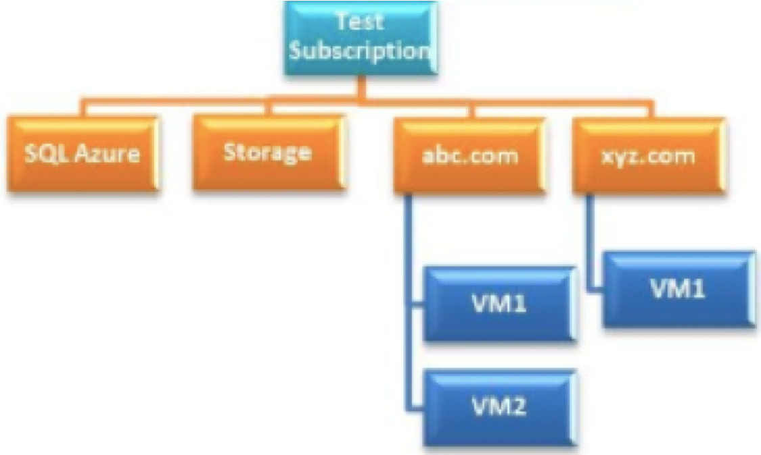

Slide 12

Azure AD Join

Slide 13
Hybrid Azure AD Join

Slide 14
Pre-requisites
Following URLs must be reachable from the devices-
https://enterpriseregistration.windows.net
https://login.microsoftonline.com
https://device.login.microsoftonline.com
https://autologon.microsoftazuread-sso.com
Latest version of Azure AD Connect required (1.1.819.0 or later)
Computer accounts must be synced to Azure AD

Slide 15
Azure Active Directory Domain Services (ADDS)

Slide 16
Module Overview
What is Azure Active Directory Domain Service
How it is different from Azure Active Directory How it is different from DIY Active Directory Deployment Scenarios

Slide 17
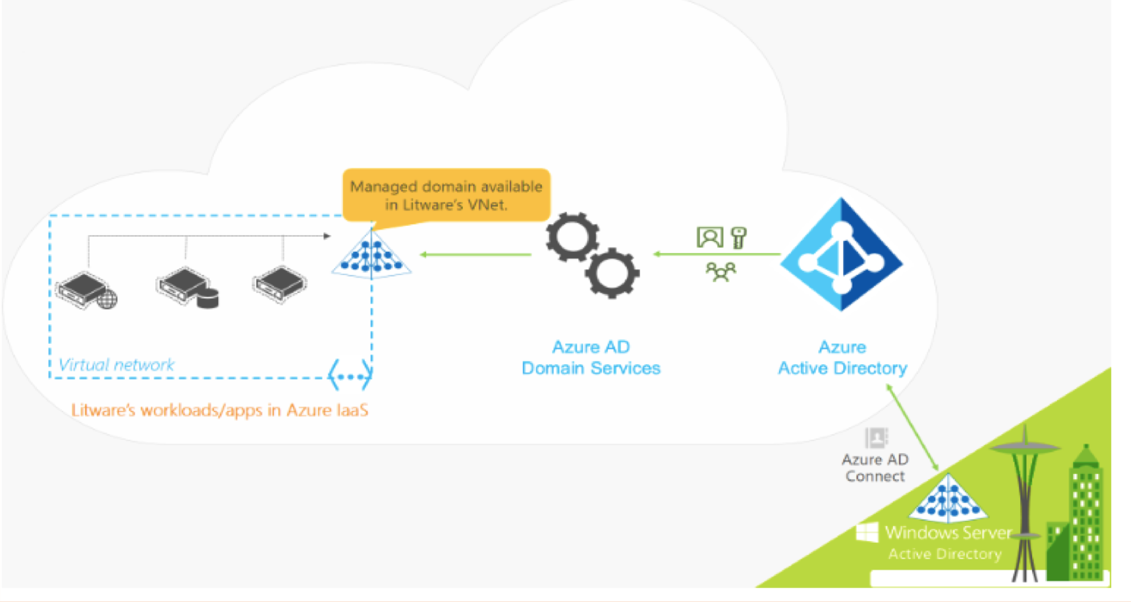
Azure Active Directory Domain Services (ADDS)
REST
Oauth 2.0 Open ID
SAML 2.0
WS-Fed 1.3 HTTP/S
Kerberos NTLM LDAP

Slide 18
Azure AD vs Azure ADDS (Managed Domain)
Aspect | Azure AD | Azure AD Domain Services
Devices Controlled by | Azure AD | Azure AD DS Managed Domain
Representation in Directory | Device objects in Azure AD | Computer objects in Managed Domain
Authentication | OAuth/OpenID/SAML based protocols | Kerberos/NTLM based protocols
Management | Mobile Device Management (MDM) software like Intune | Group Policy
Networking | Works over the Internet | Requires machines to be on the same Virtual Network as the Managed domain
Great for.. | End-user mobile or laptop devices | Server VMs deployed in Azure

Slide 19
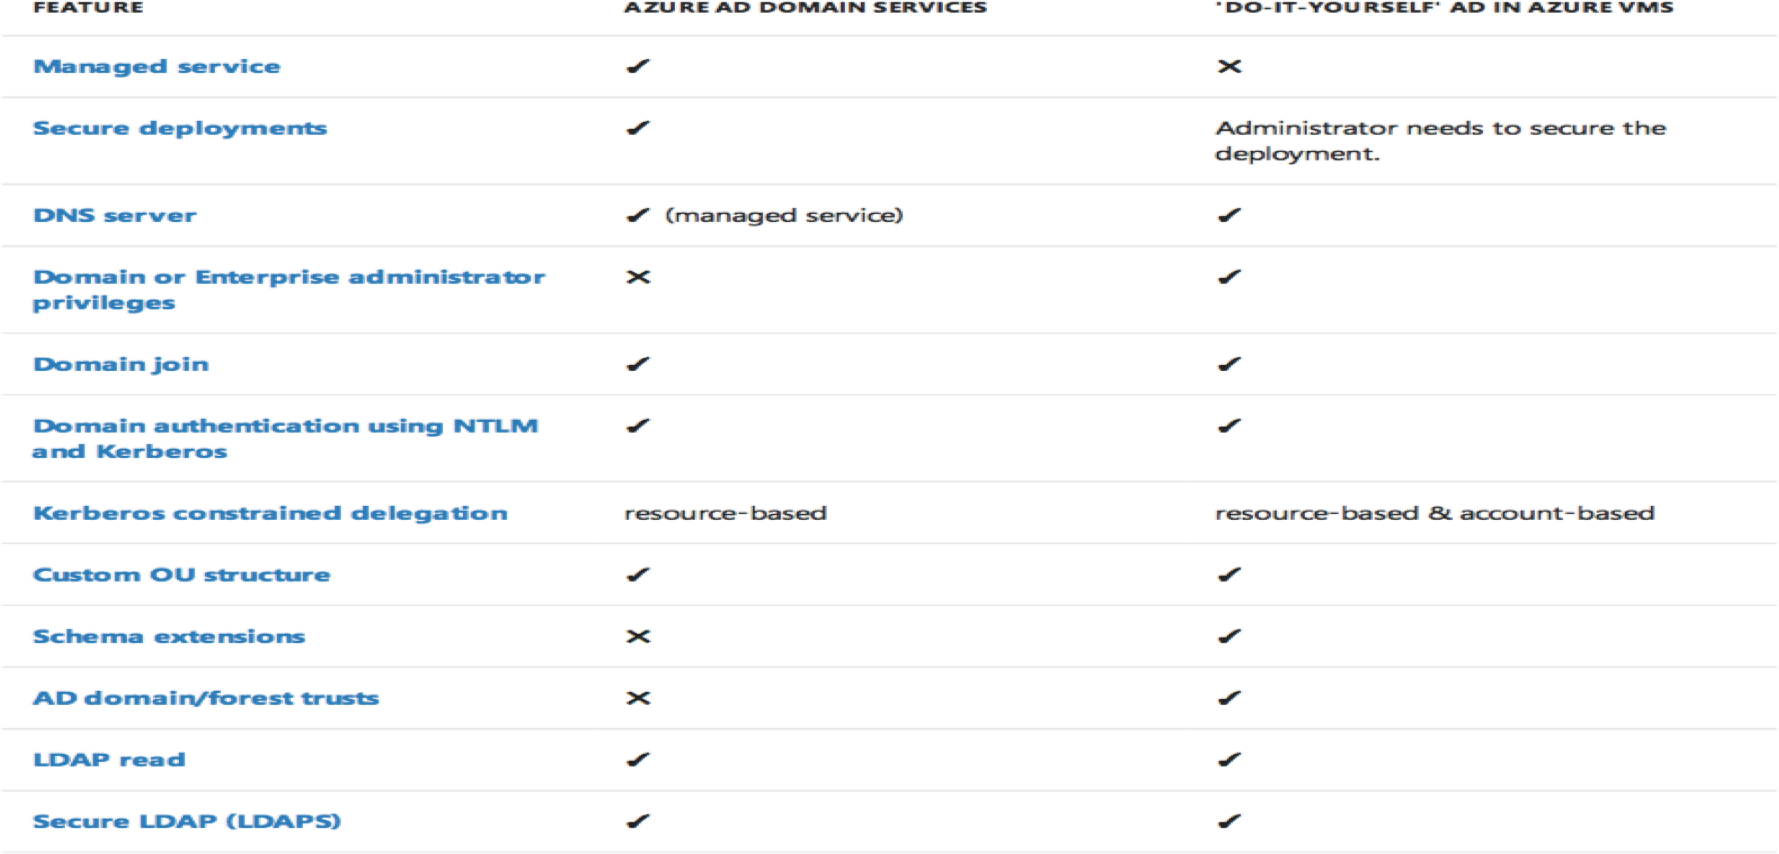
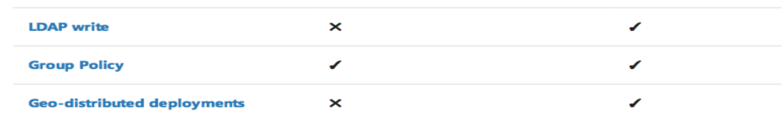
Azure ADDS vs DIY AD

Slide 20
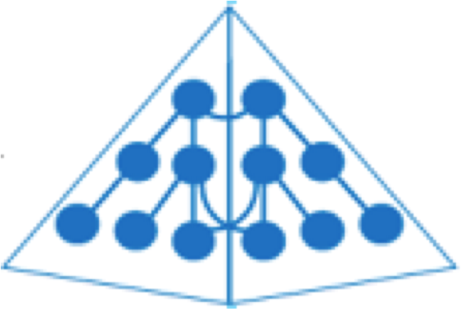




Deployment Scenario (1) for AADDS
Domain Join
Azure ADDS
Virtual Network on Azure

Slide 21
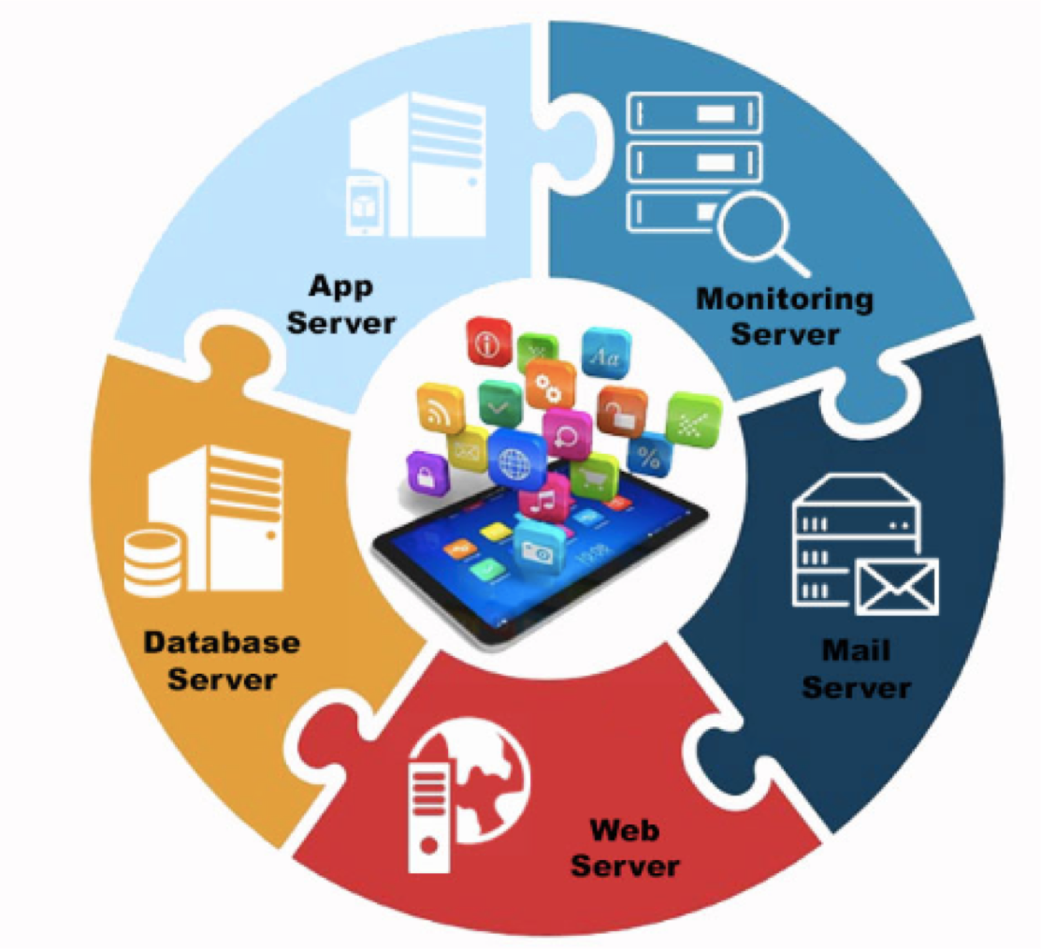
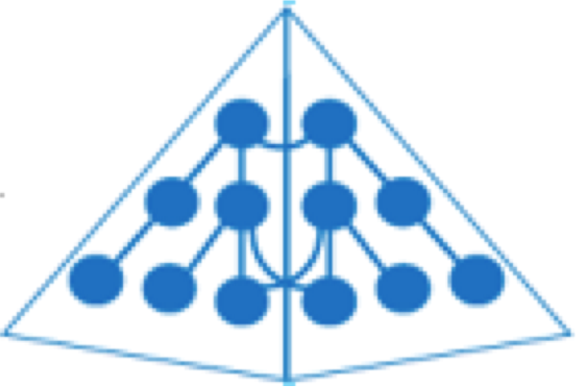



Deployment Scenario (2) for AADDS
LDAP BIND
Azure ADDS
Virtual Network on Azure

Slide 22
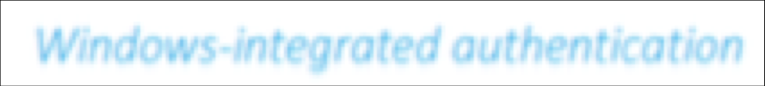
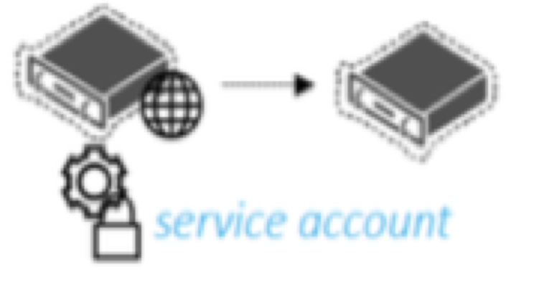
Deployment Scenario (2) for AADDS
LDAP BIND
Azure ADDS
Virtual Network on Azure

Slide 23
Configuring and Managing Azure ADDS

Slide 24
Module Overview
Creating a Custom Azure AD Domain
Integrating Azure AD with On-Prem AD Enabling and Configuring Azure ADDS Managing Azure ADDS

Slide 25
Creating a Custom Domain in Azure AD

Slide 26
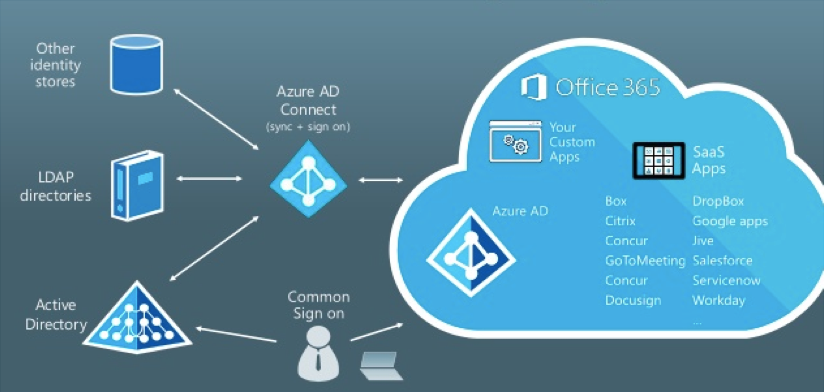
Integrating Azure AD with On-Prem AD

Slide 27
Enabling And Configuring Azure ADDS

Slide 28
Joining a Windows VM to Azure ADDS

Slide 29
VNET Peering

Slide 30
Administering Azure ADDS Managed Domain

Slide 31
Deleting Azure ADDS Managed Domain

Slide 32
Azure AD B2B Collaboration and B2C
Identities

Slide 33
Module Overview
Azure AD B2C Explained Create Azure AD B2C Tenant
Register a sample application in Azure AD B2C Create and Test a User Flow in Application
Add Facebook as an Identity Provider in Application
Azure AD B2B Collaboration
Invite external users for B2B collaboration
Type of Guest Accounts Supported and Authentication Flow in B2B
Add Google as an identity provider in Azure AD B2B Enable Email OTP authentication for B2B Guest User

Slide 34
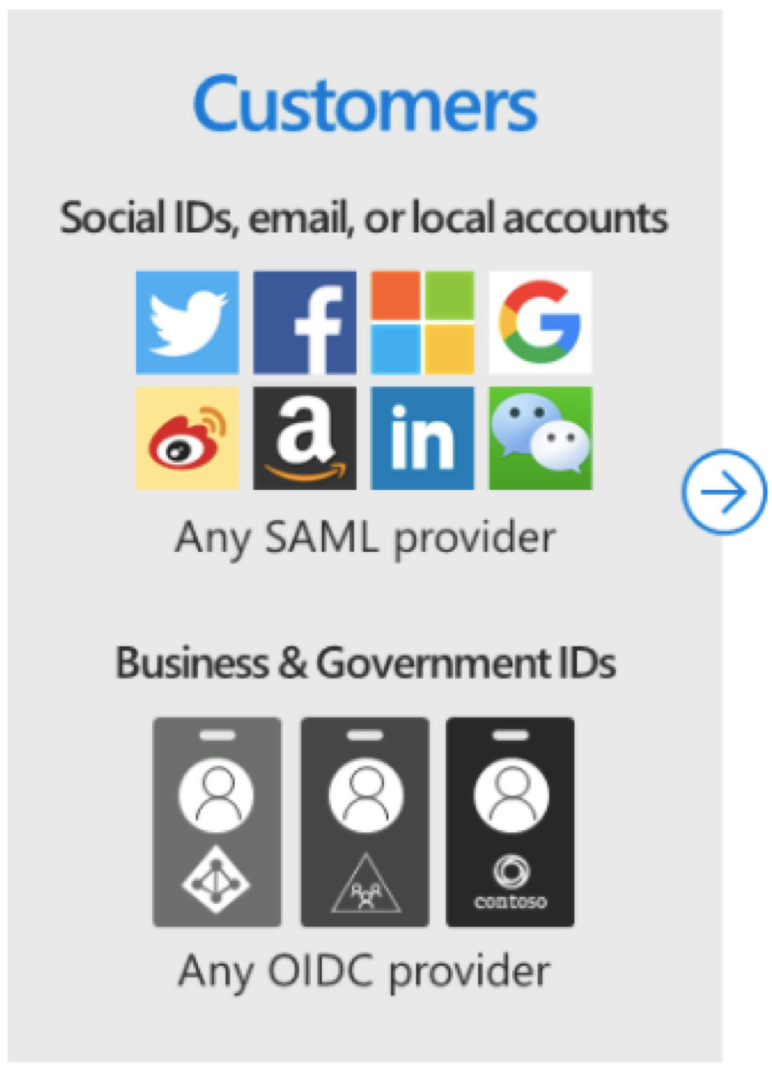
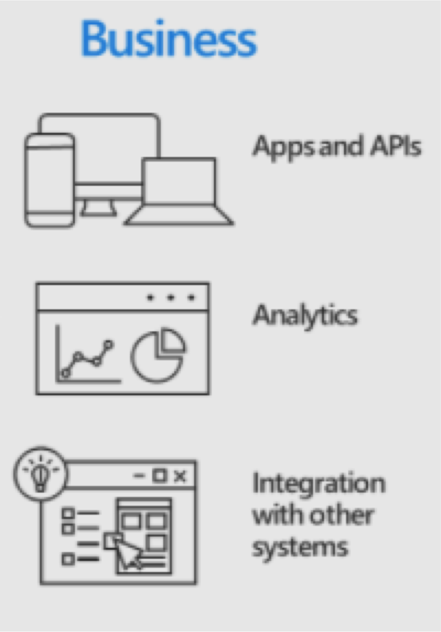
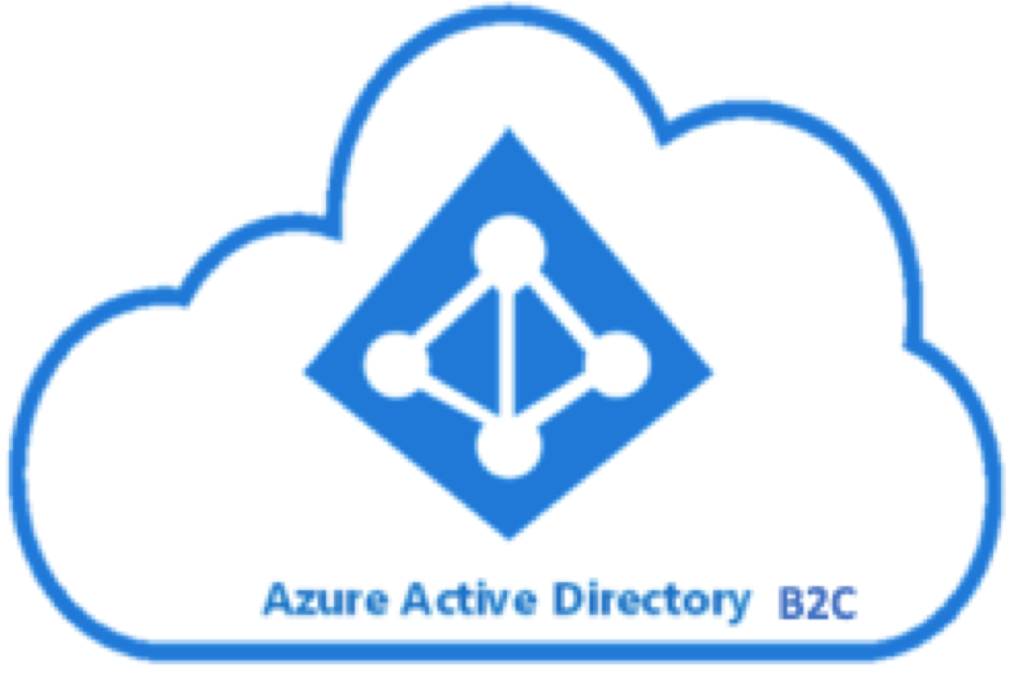
Azure AD B2C Explained
OAuth
OIDC
Customer Identity Access Management Solution

Slide 35
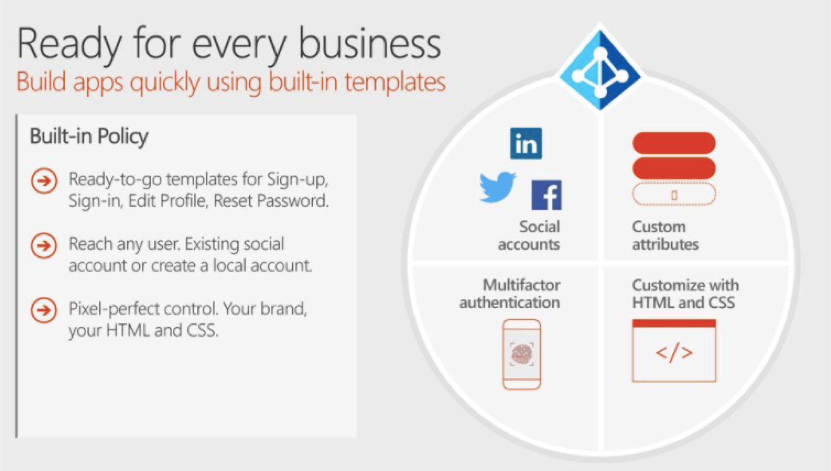
Azure AD B2C Explained

Slide 36
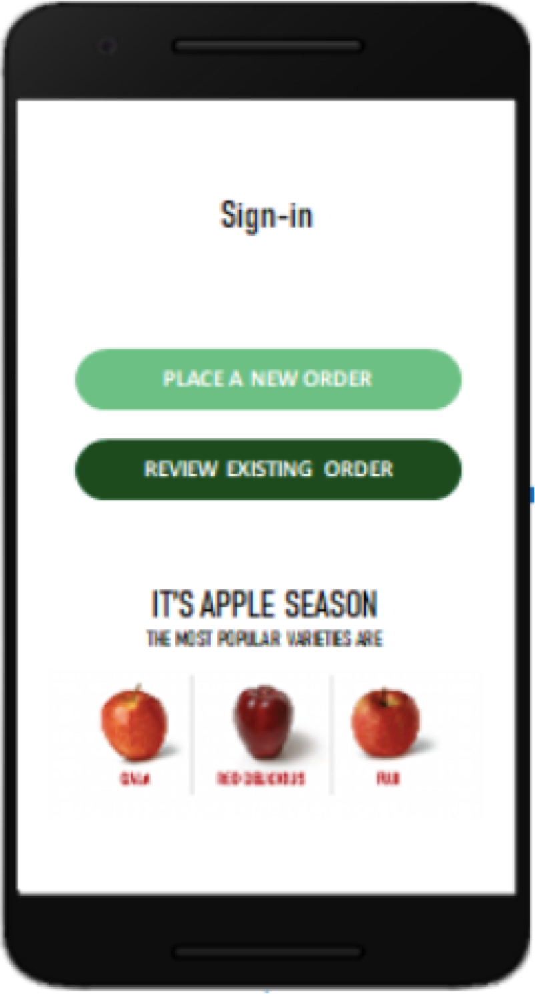
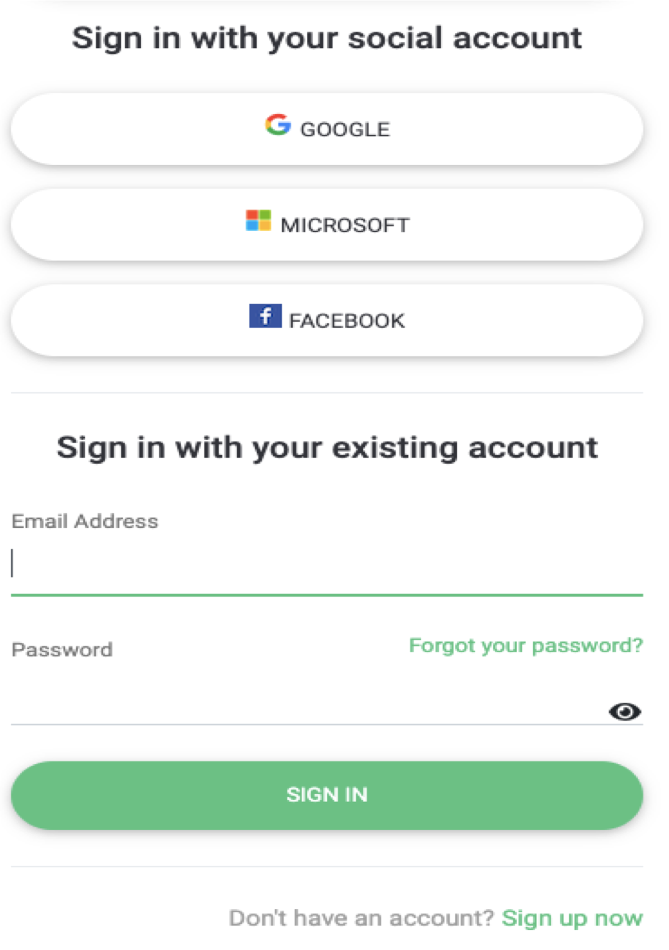
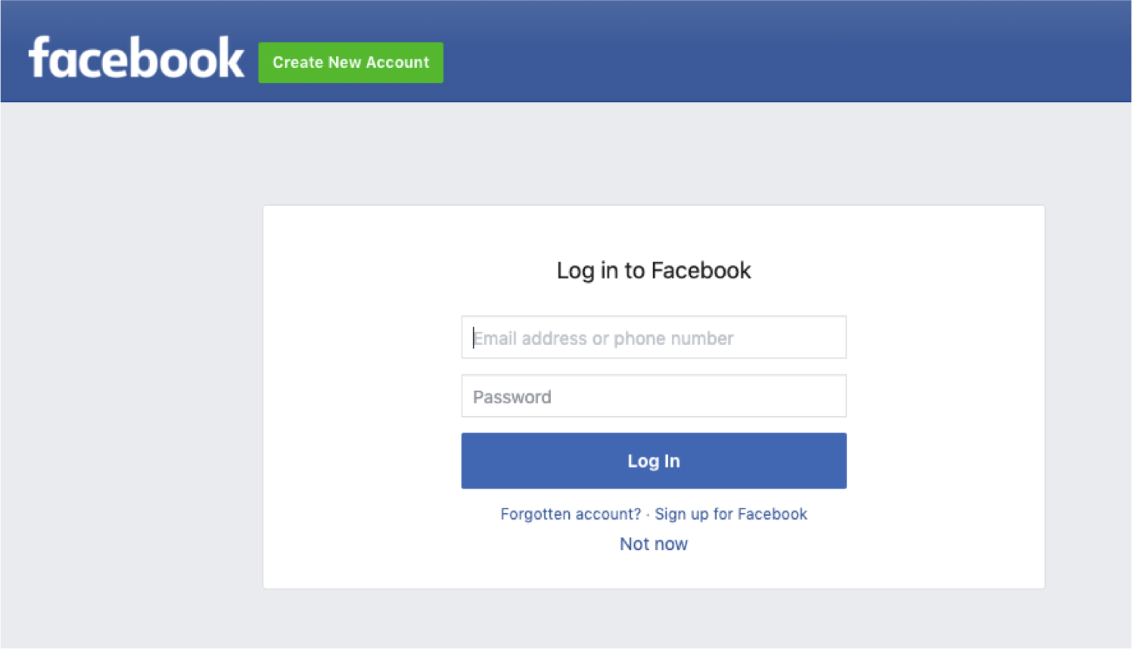
Seamless Token Redirection
Token Redirection

Slide 37
Create Azure AD B2C Tenant

Slide 38
Register a sample application in Azure AD B2C

Slide 39
Create and Test a User Flow in Application

Slide 40
Add Facebook as an Identity Provider in Application

Slide 41
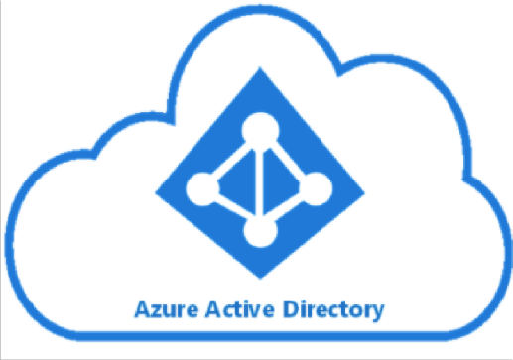

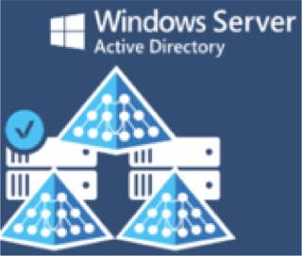







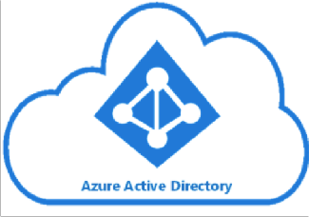


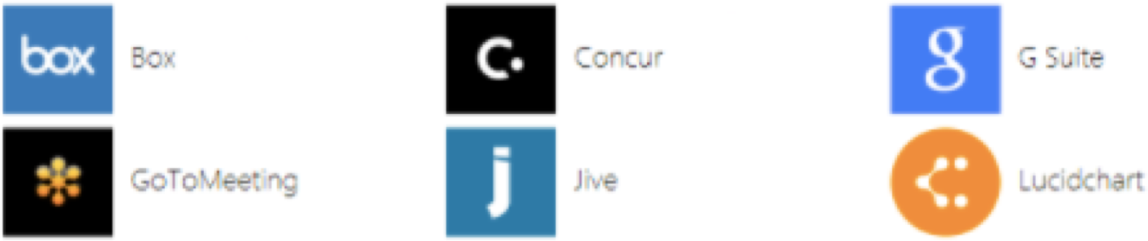
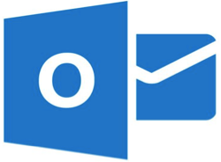
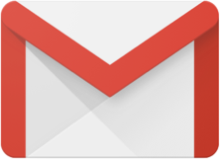






Azure AD B2B Collaboration
Partner Org
Kcloudsol.onmicrosoft.com
supplier.onmicrosoft.com
Contractors

Slide 42
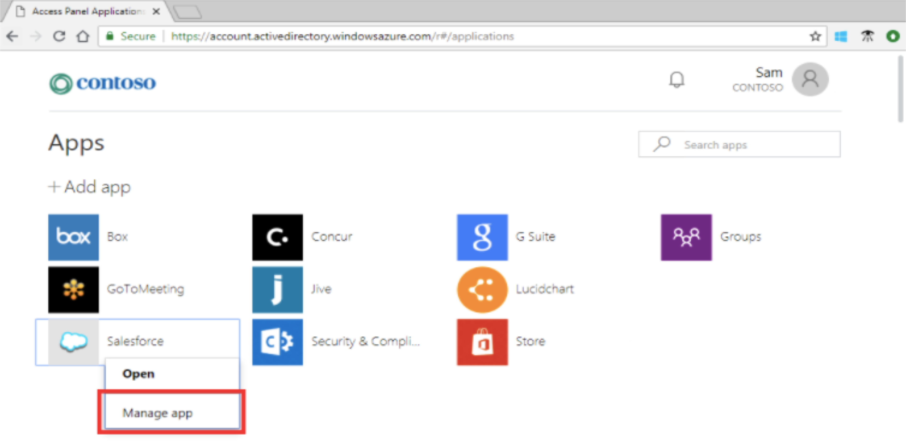
Azure AD B2B Explained

Slide 43
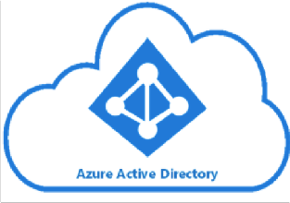
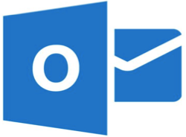
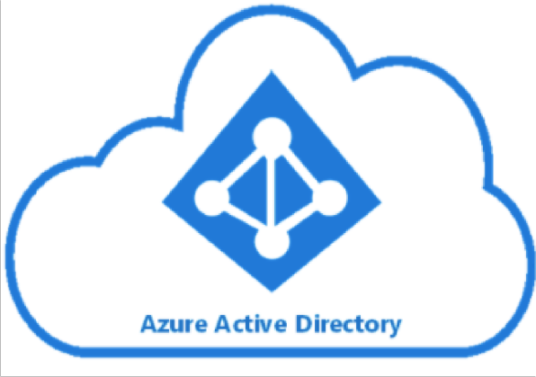





Which Type of Guest Accounts are allowed in B2B
Microsoft Accounts
On-Prem AD (non federated)
On-Prem AD (Federated)

Slide 44



Collaboration with a Microsoft Account guests
1
1. Himanshu.rana@outlook.com initiates access to PowerBI app of Yampanet
2. Yampanet finds that the user has been invited
Himanshu.rana@outlook.com sam@yahoo.com
2
5
3. Yampanet sends the user to Microsoft to Sign-in
4. Microsoft Accounts returns token to Yampanet
3
5. Himanshu gains access to the app
Microsoft Accounts
4
Inviting Azure AD Yampanet Org

Slide 45

Collaboration with Azure AD Partners
1
1. josh@kcloudsol.com initiates access to PowerBI app of Yampanet organization
2. Yampanet finds that the user has been invited
josh@kcloudsol.com
2
5
3. Yampanet sends the user to Kcloud Solutions to sign-in
4. KcloudSol returns token to Yampanet
3
5. Josh gains access to the app
4
Partner Azure AD Kcloudsol Org
Inviting Azure AD Yampanet Org

Slide 46

Collaboration with Gmail Guests
1
1. Sylvain.cort@gmail.com initiates access to PowerBI app of Yampanet Org
2. Yampanet finds that the user has been invited
Sylvain.cort@gmail.com
2
5
3. Yampanet sends the user to Google Solutions to sign-in (only in case of direct federation with Google)
3
4. Google returns token to Yampanet
5. Sylvain gains access to the app
4
Inviting Azure AD Yampanet Org

Slide 47
Invite external users for B2B collaboration

Slide 48
Add Google as an identity provider in Azure AD B2B

Slide 49
Enable Email OTP authentication for B2B Guest User

